Slide 1




DIGITAL LITERACY
SKILLS
ADVANCED USERS

Slide 2
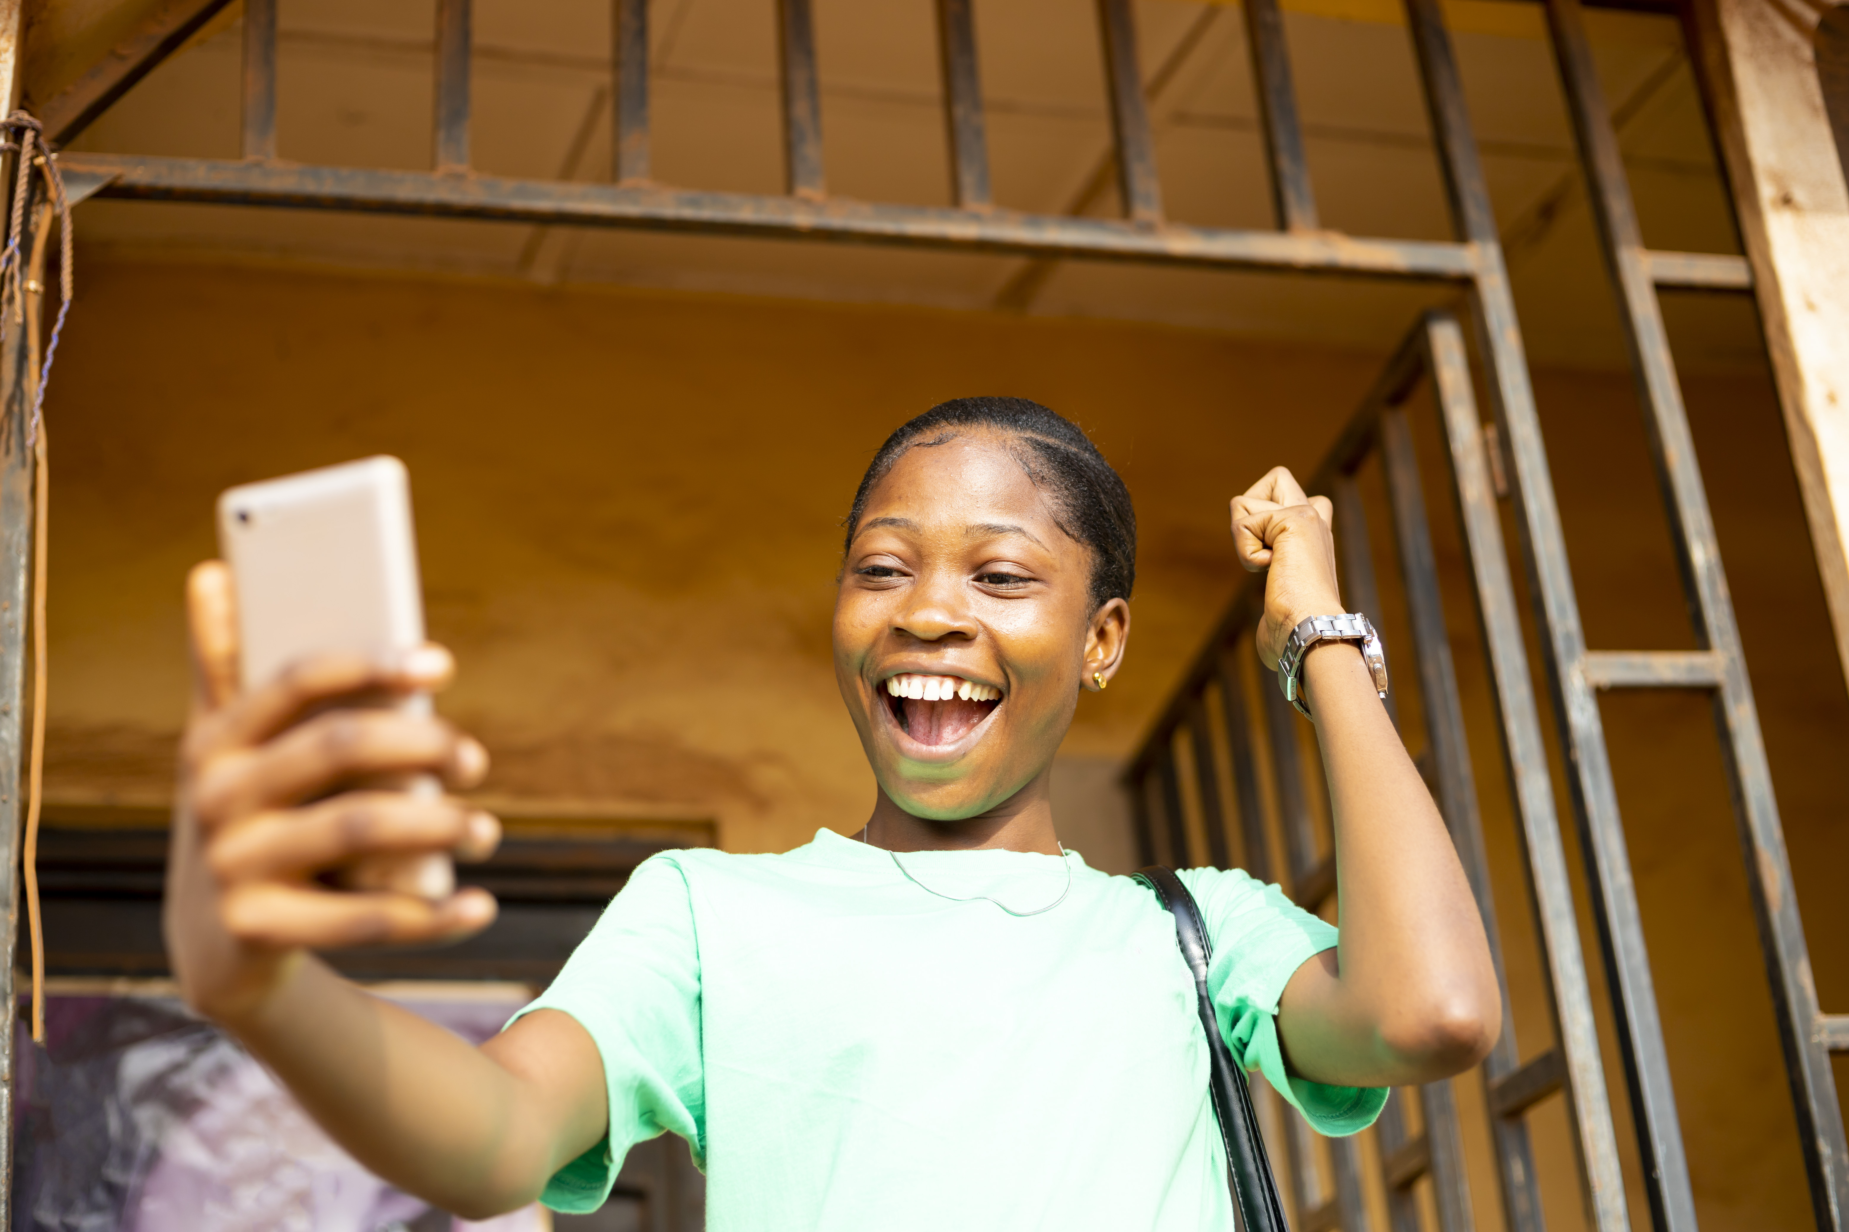
Module 4
Content

Slide 3

2
Unit 2: Integrating and
re-elaborating digital content

Slide 4
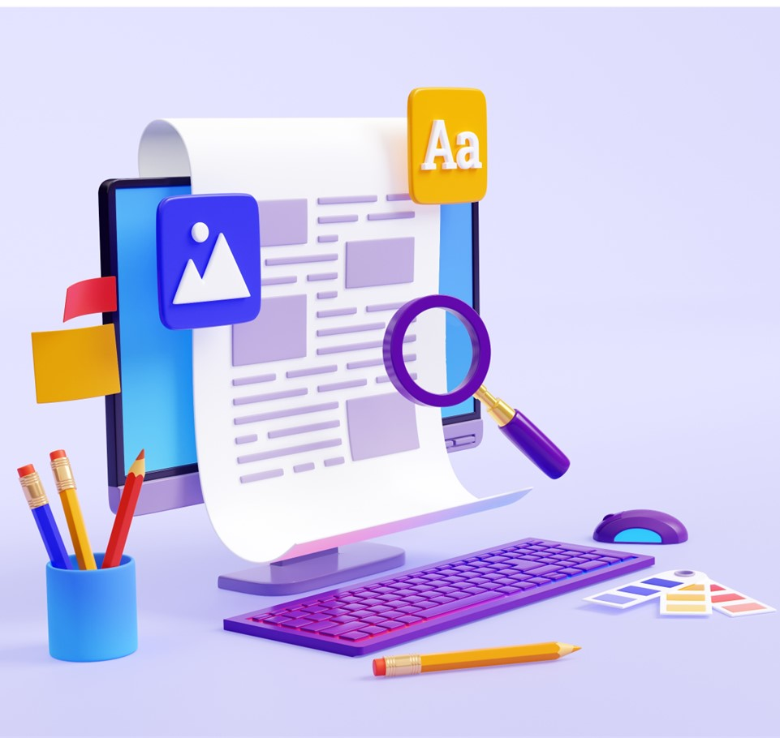
Content creation
Content creation and integration is to modify, refine and integrate new information and content into an existing content and resources to create new, original and relevant content and knowledge.
You should ask: Who am I trying to reach?
Start by carrying out research to ensure you are making the right choice.

Slide 5
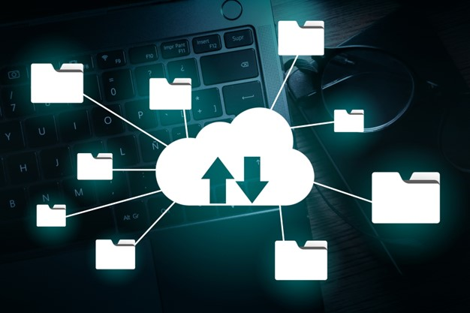
Storing your content
You should know the safest way save your content for ease of access but also security.
Cloud file sharing can be a useful platform, which allows you to access content from any device.
Discover Dropbox, Google Drive, and One Drive and change the way you share your materials.

Slide 6
Skills to practise
Practise advanced formatting
Send multiple emails using mail merge. Watch this video and follow the instructions: https://www.youtube.com/watch?v=wxUZ9uYjWMg
Now send an email to all your class members or members of a group that you belong to, informing them of an upcoming event.
Watch this video that will show you how to merge two MS Word documents: https://www.youtube.com/watch?v=SX3gQAHh53A
Now, select two documents that you have save previously and merge them into one document.

Slide 7
All back covers should include
contact information of the section
producing the work.
© United Nations Children’s Fund (UNICEF) [month and year of publication]

